Slide 1

Email Classifier
Presented By:
Group 2
(Group Members: Gowthami, Nabanita, Anusha, Nikita)
Mentor Name : Varun
Date: 09/01/2021

Slide 2
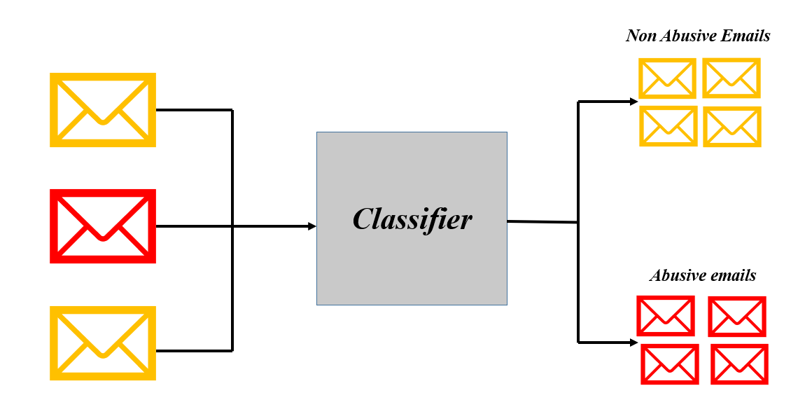
Business Problem:
Inappropriate emails would demotivates and spoil the positive environment that would lead to more attrition rate and low productivity and Inappropriate emails could be on form of bullying, racism, sexual favoritism and hate in the gender or culture, in today’s world so dominated by email no organization is immune to these hate emails.
Objective:
To classify mails into abusive and non abusive categories.

Slide 3
Project Architecture / Project Flow
Business Objective
Data Collection
EDA Data Preprocessing
Model Building
Model Evaluation
Deployment

Slide 4
Exploratory Data Analysis (EDA) and
Feature Engineering

Slide 5
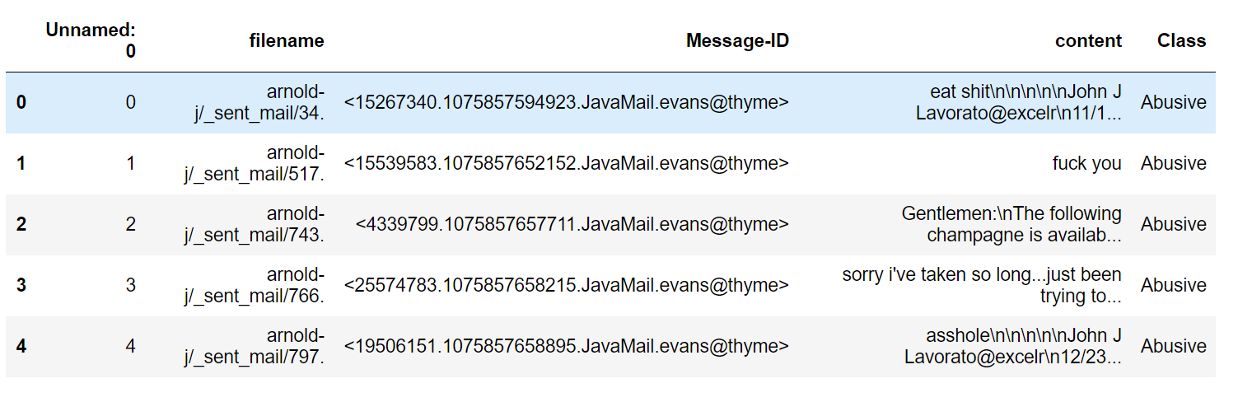
Data set details:
No. of Columns: 5
No. of Records : 48076
Features of interest:
1. Independent Variable, X = content
2. Dependent Variable, y = Class

Slide 6
Exploratory Data Analysis (EDA):
Data Preprocessing
A.) Data Cleaning
Removal of “\n” Characters
Converting to lower
Removal of special Characters and numbers
Removal of hyperlinks
Removal of whitespaces
Removal of Stop words
B.) Text Normalization - Lemmatization
C.) Vectorization- Term Frequency Inverse Document Frequency
D.) Label Encoding
There are 25314 duplicated records
Dropped duplicated records
No. of records = 22762

Slide 7
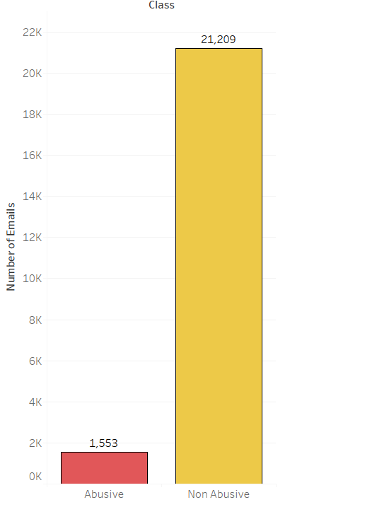
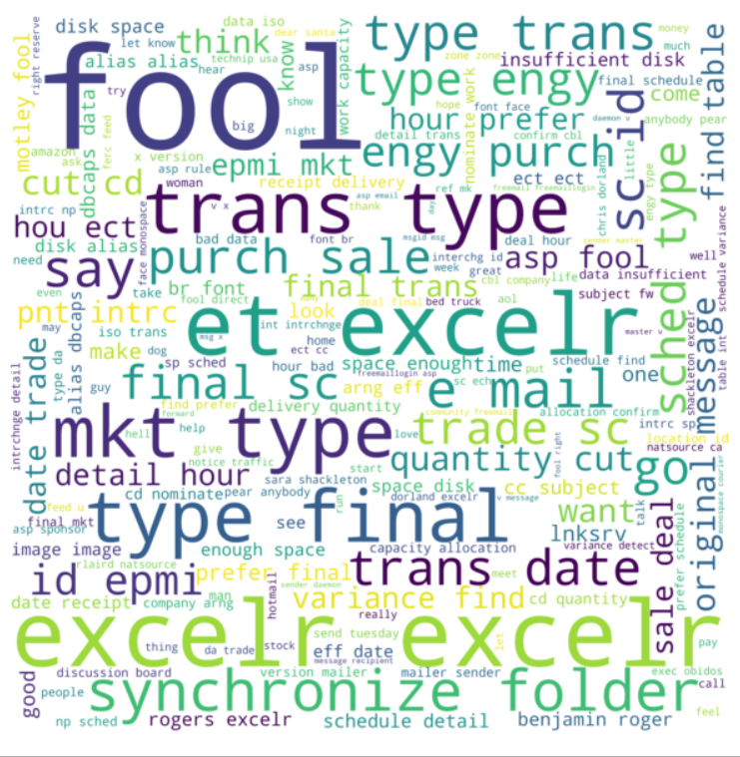
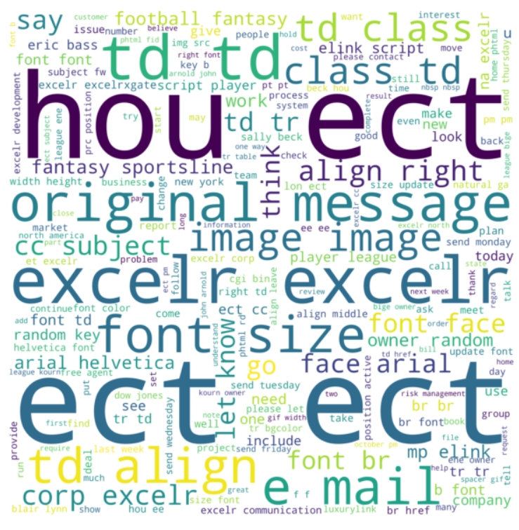
EDA:
Fig:- Word Clouds for abusive emails
Fig:- Word Clouds for non-abusive emails

Slide 8
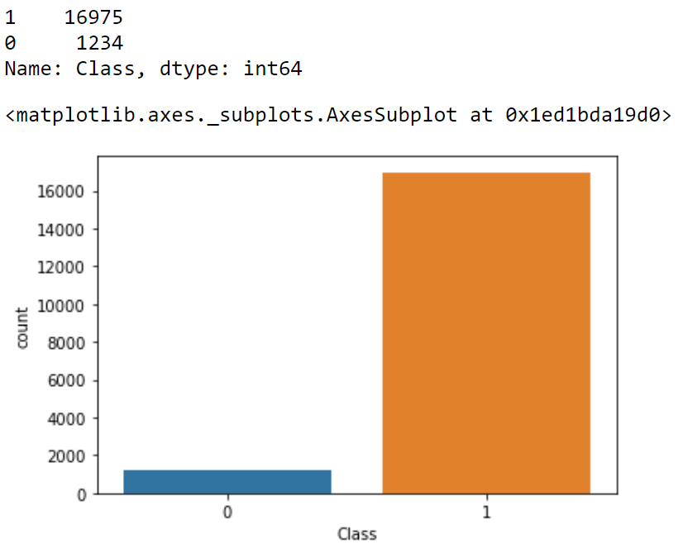
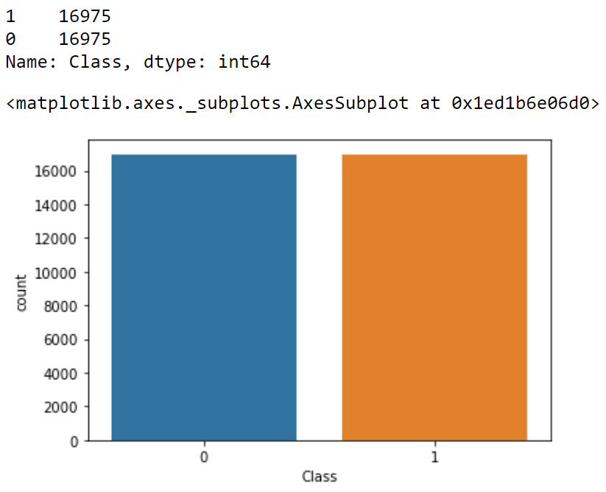
Feature Engineering
SMOTE
Imbalanced Data
Balanced Data

Slide 9
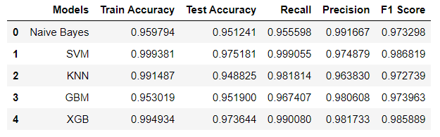
Template for Model results presentation
Algorithms
Data set details
1. Independent Variable, X = content
2. Dependent Variable, y = Class
Naïve Bayes
Support Vector Machines
K-Nearest Neighbor
Gradient Boosting
XGB
Data Partition details
80% Train Data
20% Test data
Model Evaluation

Slide 10
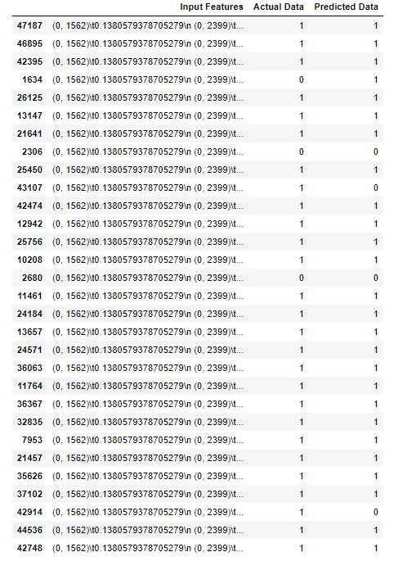
Model Predictions
Data fed to the model
Predicted Output

Slide 11
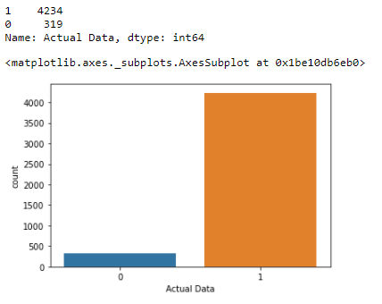
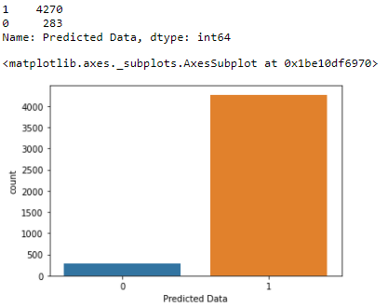

Model Results

Slide 12
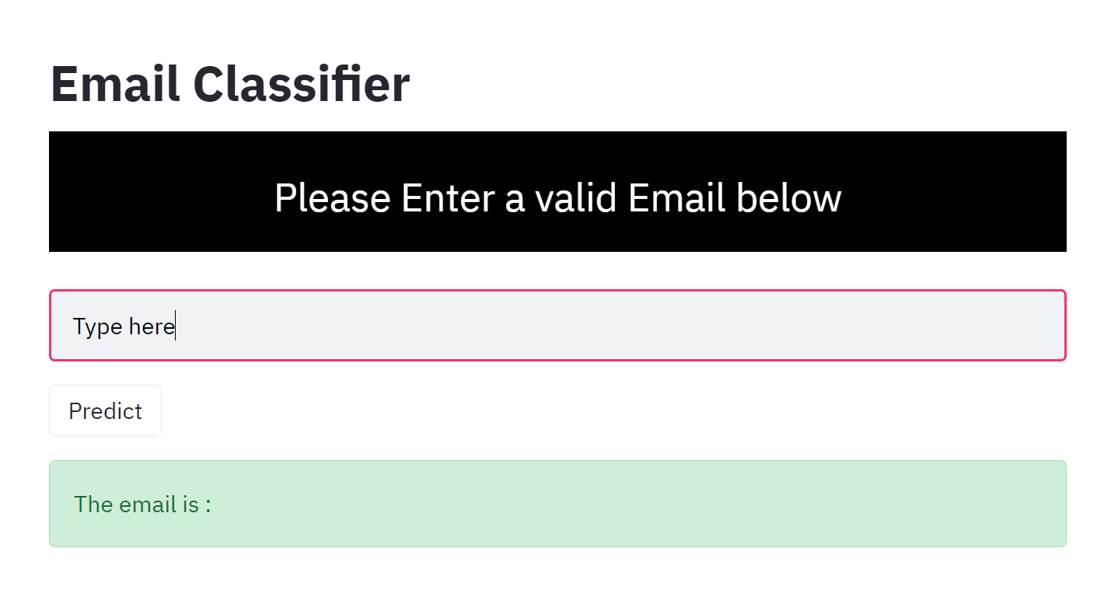
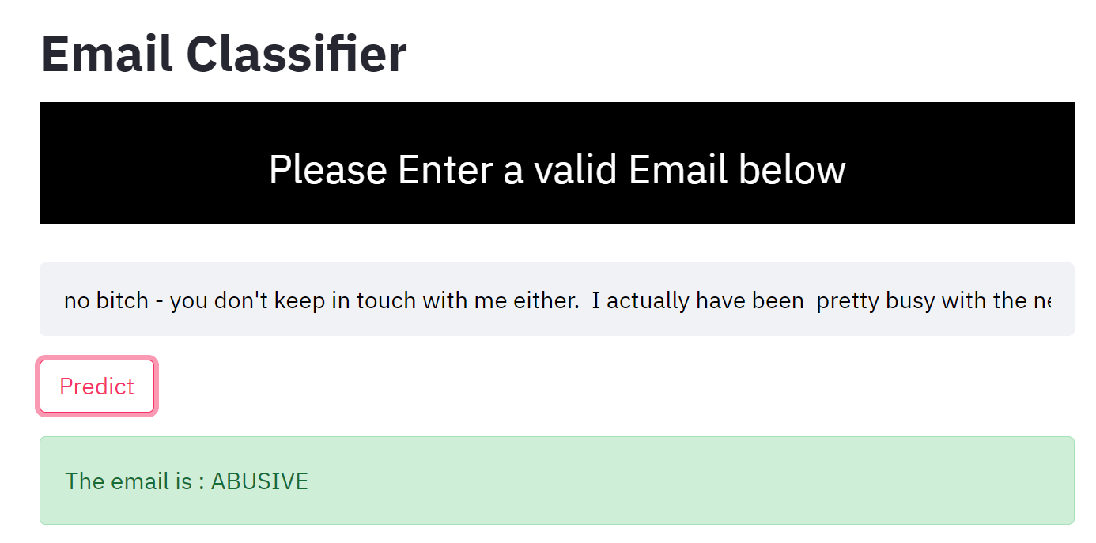
Model Deployment
Used Streamlit for deployment

Slide 13
Challenges faced?
Data received is of poor quality and in extremely raw format.
Imbalanced dataset.
How did you overcome?
Data is preprocessed and cleaned so model can understand it properly .
Dataset is balanced applying different oversampling and undersampling technique.

Slide 14
Thank you

